Slide 1

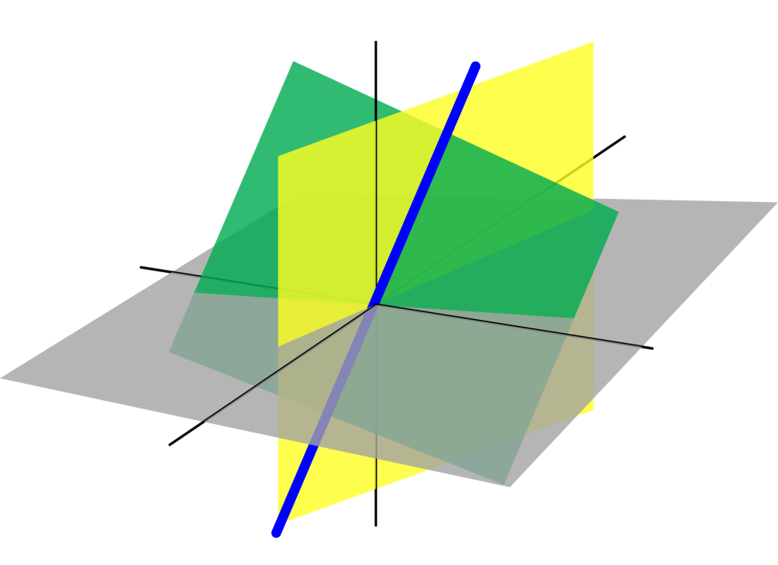
Azərbaycan Dövlət Neft və Sənaye Universiteti
Analytical Geometry

Slide 2
Lines in Space

Slide 3
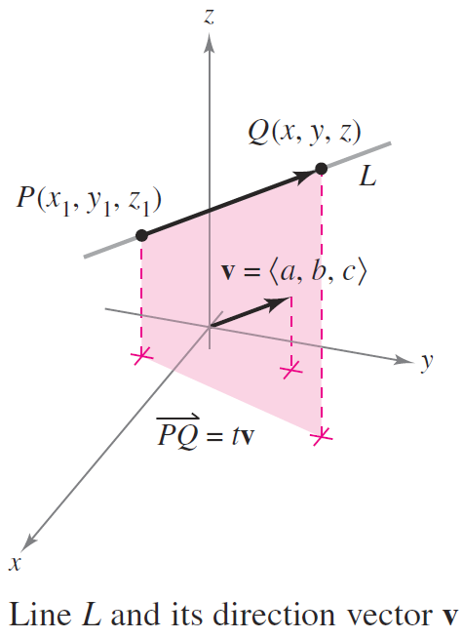
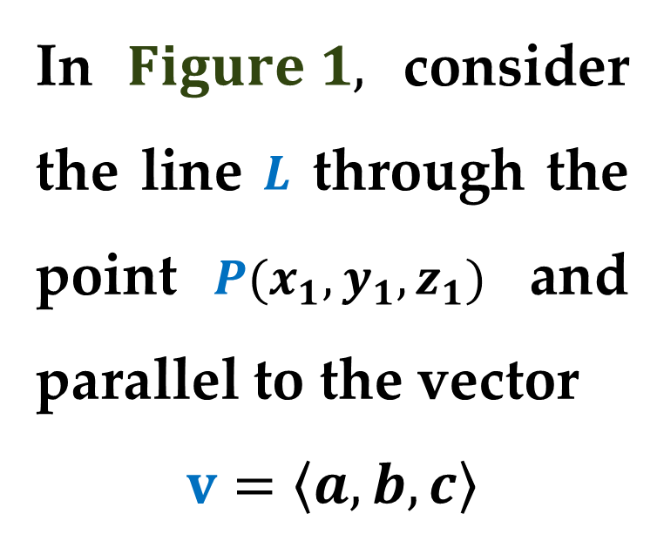
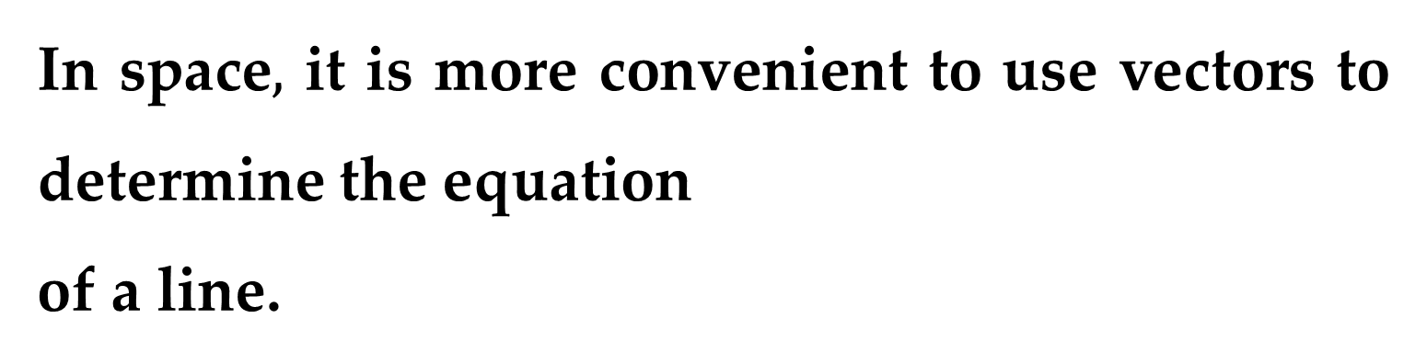
In space$,$ it is more convenient to use vectors to determine the equation
of a line.
In $Figure 1,$ consider the line $L$ through the point $P(x_{1},y_{1},z_{1})$ and parallel to the vector
$$v=\left\langle a,b,c\right\rangle$$

Slide 4
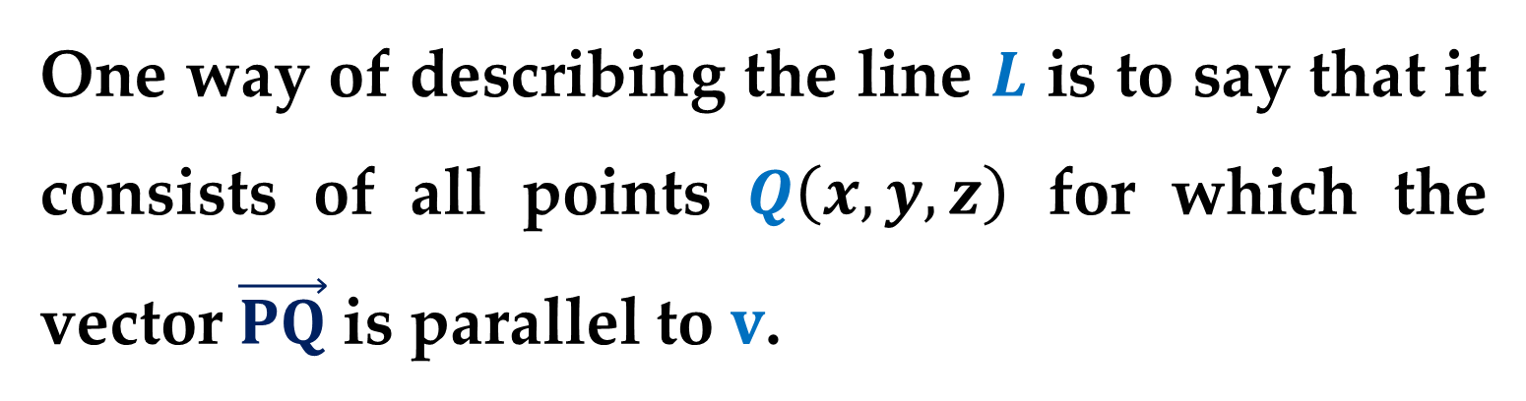
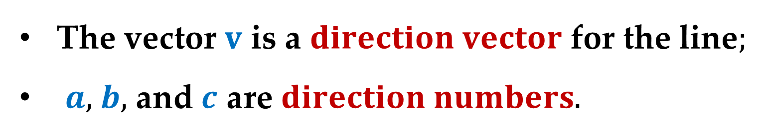
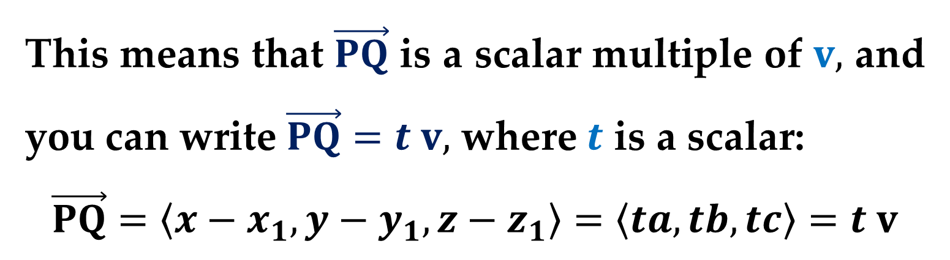
The vector $v$ is a $direction vector$ for the line$;$
$a,$ $b,$ and $c$ are $direction numbers.$
One way of describing the line $L$ is to say that it consists of all points $Q\left(x,y,z\right)$ for which the vector $\vec{PQ}$ is parallel to $v$.
This means that $\vec{PQ}$ is a scalar multiple of $v,$ and you can write $\vec{PQ}=t v,$ where $t$ is a scalar:
$$\vec{PQ}=\left\langle x−x_{1},y−y_{1},z−z_{1}\right\rangle =\left\langle ta,tb,tc\right\rangle =t v$$

Slide 5
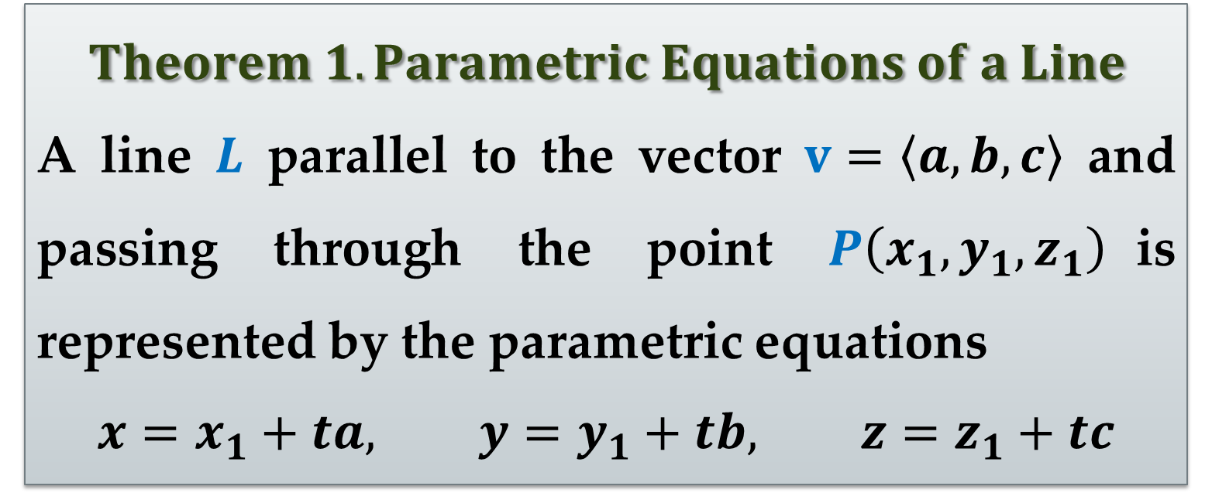
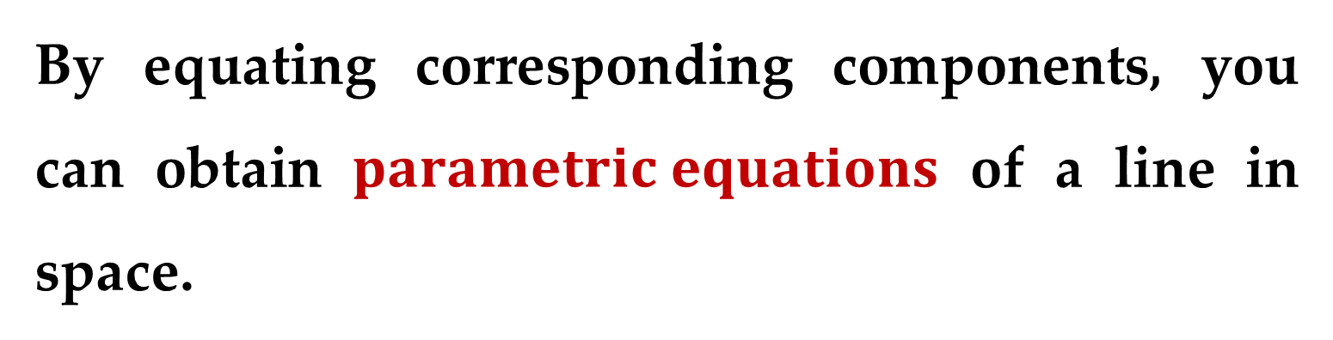
By equating corresponding components, you can obtain $parametric equations$ of a line in space.
$$Theorem 1. Parametric Equations of a Line$$
A line $L$ parallel to the vector $v=\left\langle a,b,c\right\rangle$ and passing through the point $P\left(x_{1},y_{1},z_{1}\right)$is represented by the parametric equations
$$x=x_{1}+ta, y=y_{1}+tb, z=z_{1}+tc$$

Slide 6
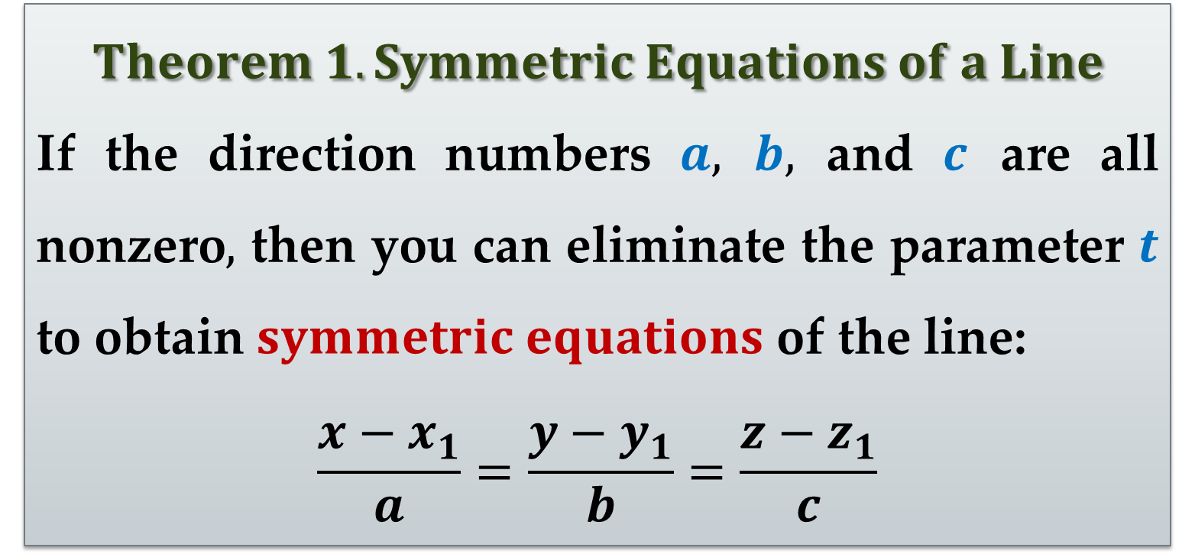
$$Theorem 1. Symmetric Equations of a Line$$
If the direction numbers $a,$ $b,$ and $c$ are all nonzero$,$ then you can eliminate the parameter $t$ to obtain $symmetric equations$ of the line:
$$\frac{x−x_{1}}{a}=\frac{y−y_{1}}{b}=\frac{z−z_{1}}{c}$$

Slide 7
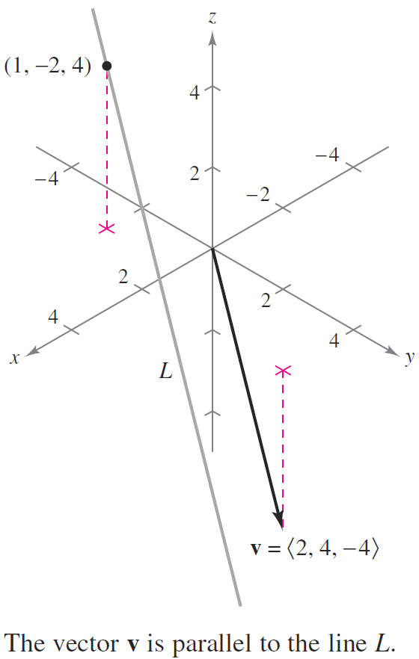
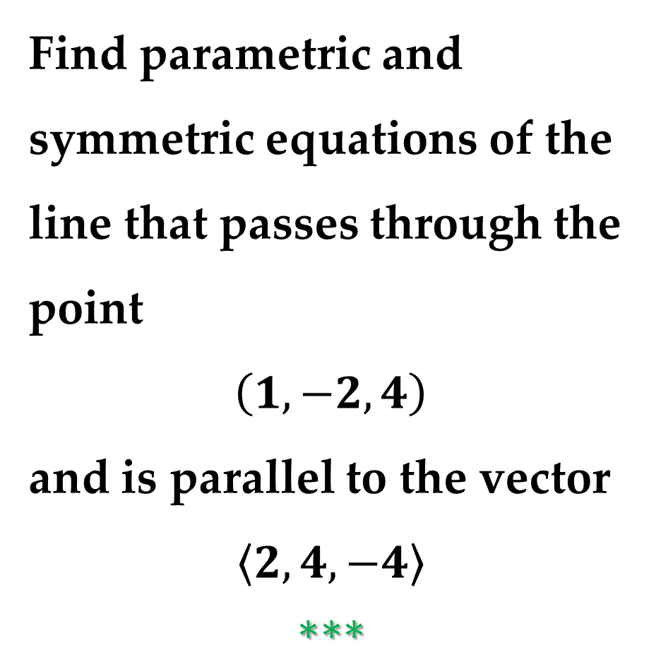

$Example 1$. Parametric and Symmetric
Equations
Find parametric and symmetric equations of the line that passes through the point
$$\left(1,−2,4\right)$$
and is parallel to the vector
$$\left\langle 2,4,−4\right\rangle$$
$$∗∗∗$$

Slide 8
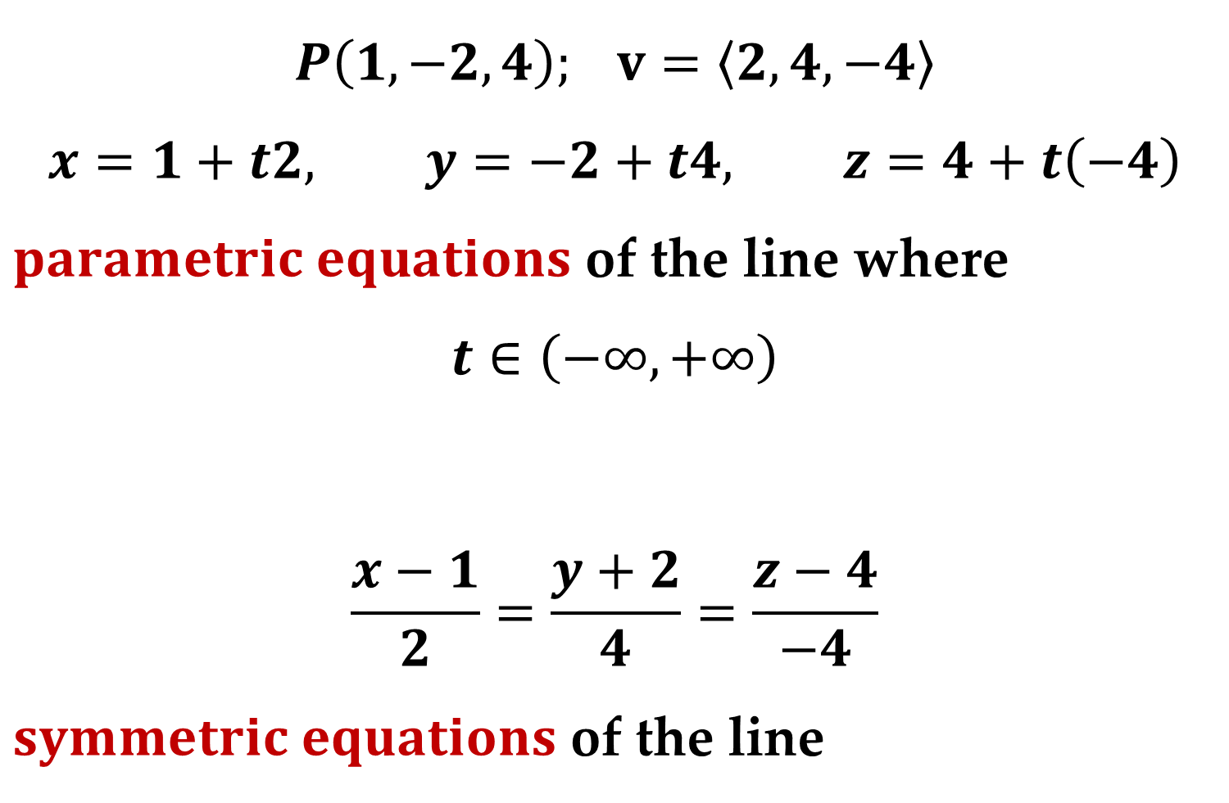
$$P\left(1,−2,4\right); v=\left\langle 2,4,−4\right\rangle$$
$$x=1+t2, y=−2+t4, z=4+t\left(−4\right)$$
$parametric equations$ of the line where
$$t∈\left(−∞,+∞\right)$$
$$\frac{x−1}{2}=\frac{y+2}{4}=\frac{z−4}{−4}$$
$symmetric equations$ of the line

Slide 9
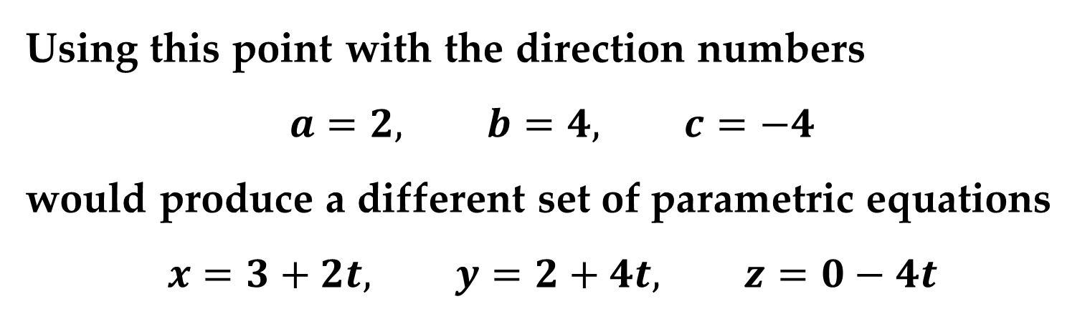
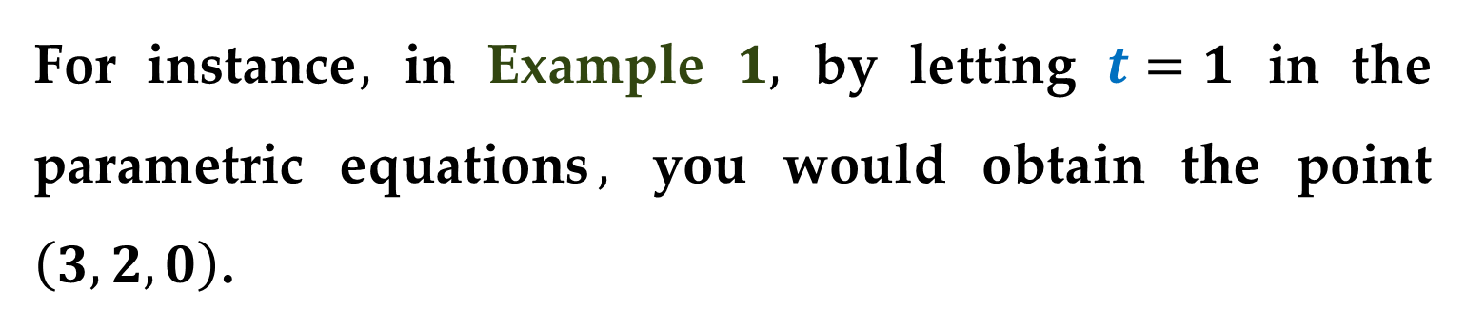
Remark
Neither parametric equations nor symmetric equations of a given line are unique.
For instance$,$ in Example $1,$ by letting $t=1$ in the parametric equations$,$ you would obtain the point $\left(3,2,0\right)$.
Using this point with the direction numbers
$$a=2, b=4, c=−4$$
would produce a different set of parametric equations
$$x=3+2t, y=2+4t, z=0−4t$$

Slide 10
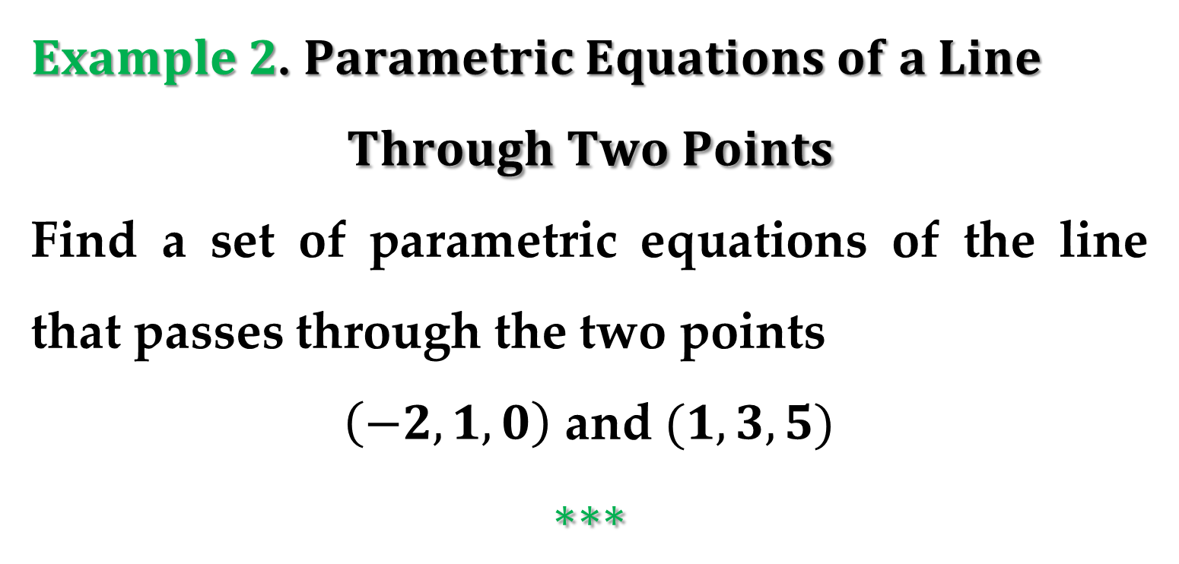
$Example 2$. $Parametric Equations of a Line$
$$Through Two Points$$
Find a set of parametric equations of the line that passes through the two points
$\left(−2,1,0\right)$ and $(1,3,5)$
$$∗∗∗$$

Slide 11
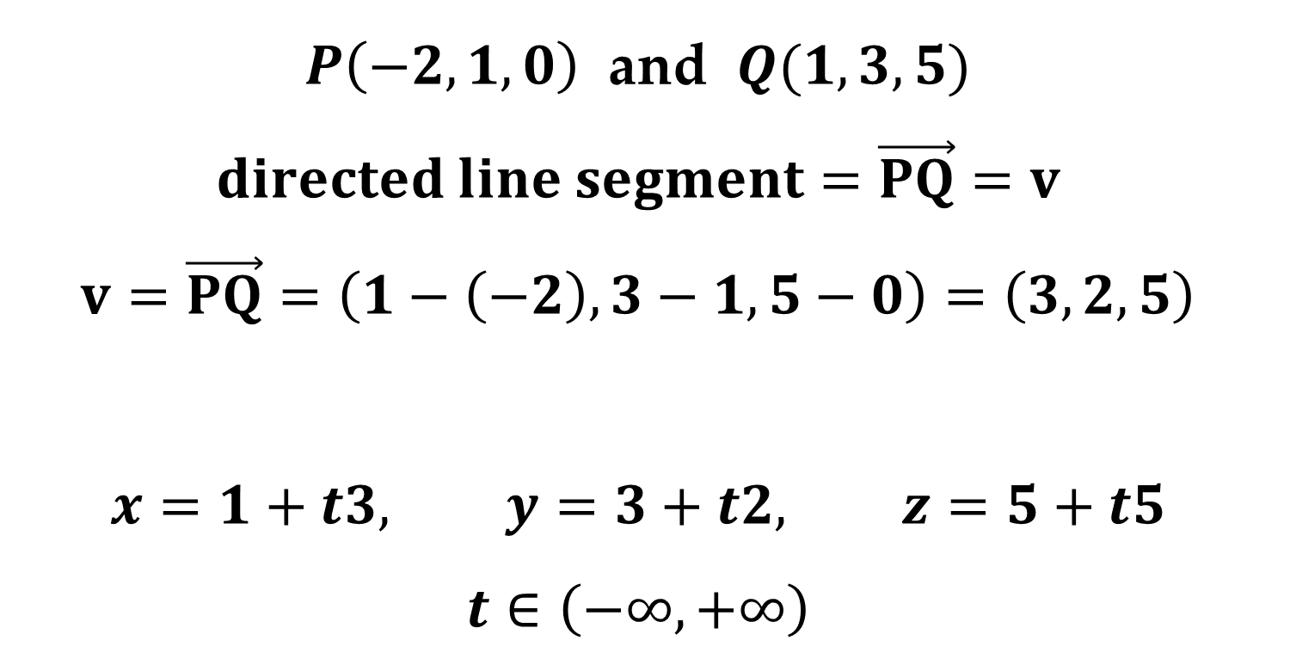
$P\left(−2,1,0\right)$ and $Q(1,3,5)$
$$directed line segment=\vec{PQ}=v$$
$$v=\vec{PQ}=\left(1−\left(−2\right),3−1,5−0\right)=\left(3,2,5\right)$$
$$x=1+t3, y=3+t2, z=5+t5$$
$$t∈\left(−∞,+∞\right)$$

Slide 12
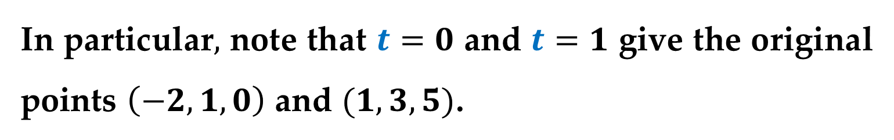
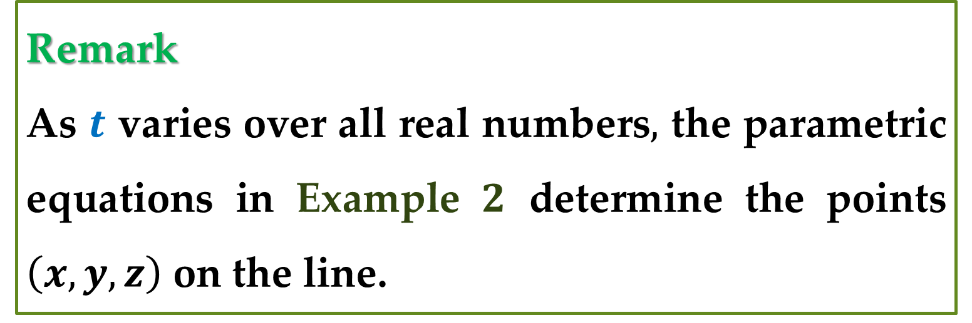
Remark
As $t$ varies over all real numbers$,$ the parametric equations in Example $2$ determine the points $\left(x,y,z\right)$ on the line.
In particular$,$ note that $t=0$ and $t=1$ give the original points $\left(−2,1,0\right)$ and $(1,3,5)$.

Slide 13
Planes in Space

Slide 14
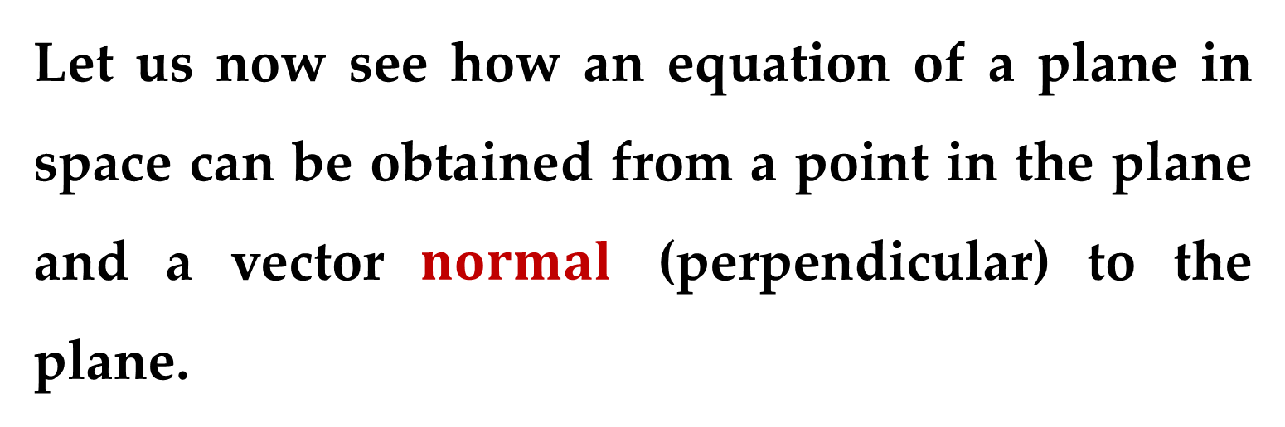
We have just seen how an equation of a line in space can be obtained from a point on the line and a vector parallel to it.
Let us now see how an equation of a plane in space can be obtained from a point in the plane and a vector $normal$ (perpendicular) to the plane.

Slide 15
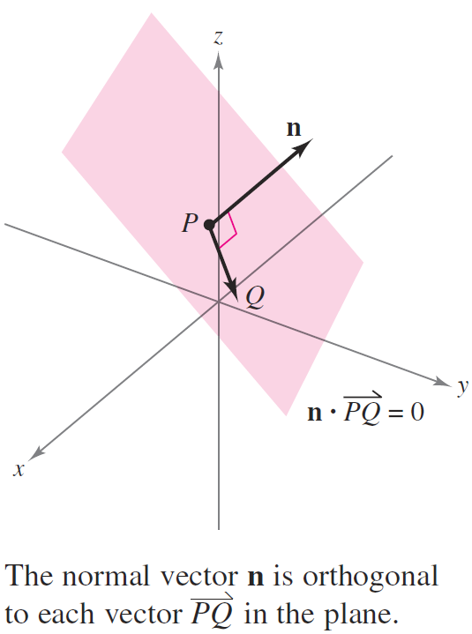
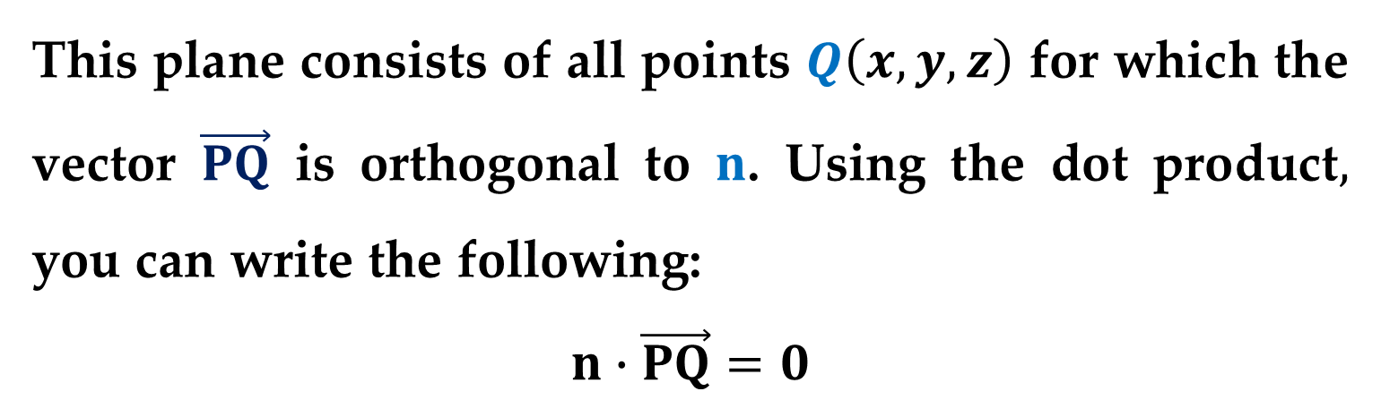
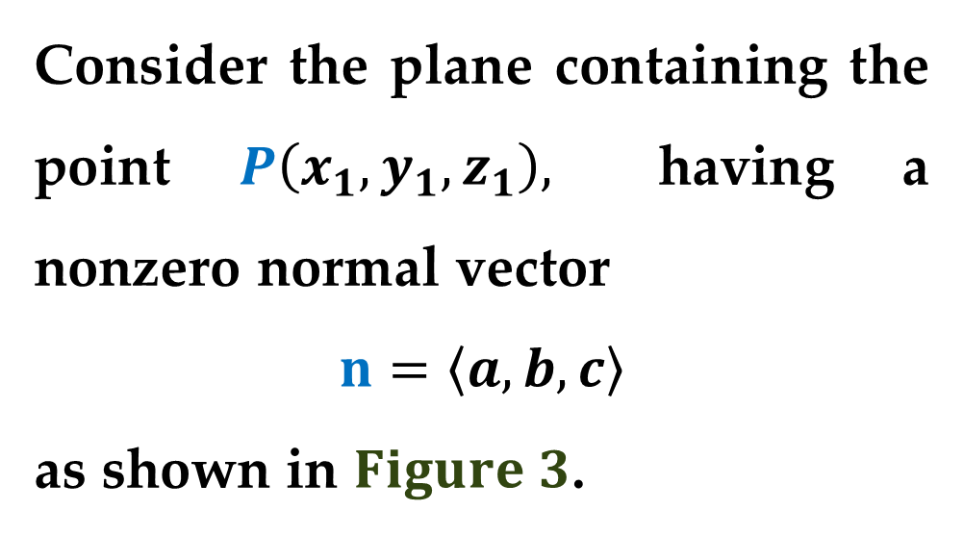
Consider the plane containing the point $P\left(x_{1},y_{1},z_{1}\right),$ having a nonzero normal vector
$$n=\left\langle a,b,c\right\rangle$$
as shown in $Figure 3$.
This plane consists of all points $Q\left(x,y,z\right)$ for which the vector $\vec{PQ}$ is orthogonal to $n$. Using the dot product$,$ you can write the following:
$$n∙\vec{PQ}=0$$

Slide 16
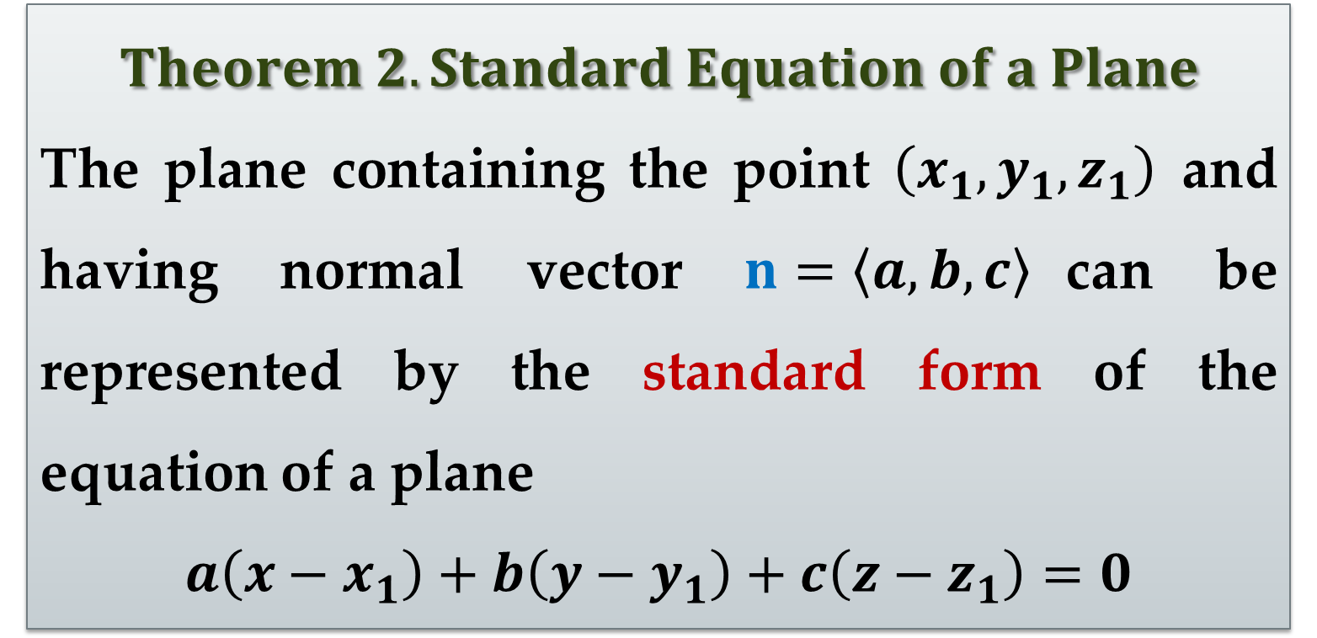
$$\left\langle a,b,c\right\rangle ∙\left\langle x−x_{1},y−y_{1},z−z_{1}\right\rangle =0$$
$$a\left(x−x_{1}\right)+b\left(y−y_{1}\right)+c\left(z−z_{1}\right)=0$$
$$Theorem 2. Standard Equation of a Plane$$
The plane containing the point $\left(x_{1},y_{1},z_{1}\right)$ and having normal vector $n=\left\langle a,b,c\right\rangle$can be represented by the standard form of the equation of a plane
$$a\left(x−x_{1}\right)+b\left(y−y_{1}\right)+c\left(z−z_{1}\right)=0$$

Slide 17
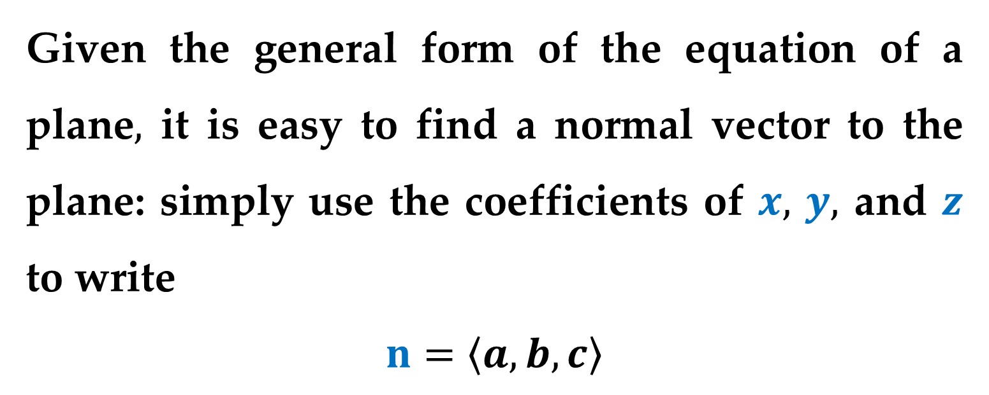
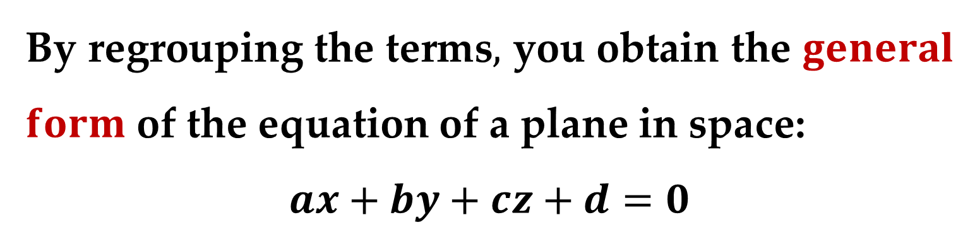
By regrouping the terms$,$ you obtain the $general$ $form$ of the equation of a plane in space:
$$ax+by+cz+d=0$$
Given the general form of the equation of a plane$,$ it is easy to find a normal vector to the plane: simply use the coefficients of $x,$ $y,$ and $z$ to write
$$n=\left\langle a,b,c\right\rangle$$

Slide 18
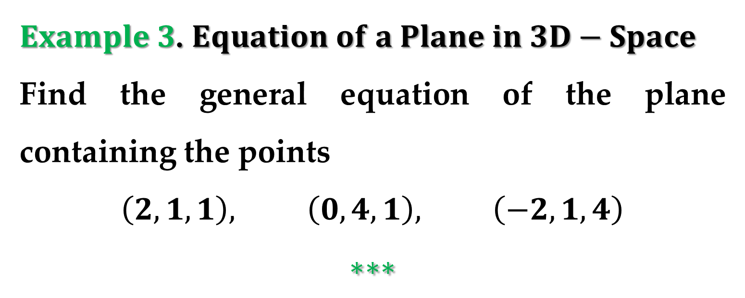
$Example 3$. $Equation of a Plane in 3D−Space$
Find the general equation of the plane containing the points
$$\left(2,1,1\right), \left(0, 4, 1\right), \left(−2,1,4\right)$$
$$∗∗∗$$

Slide 19
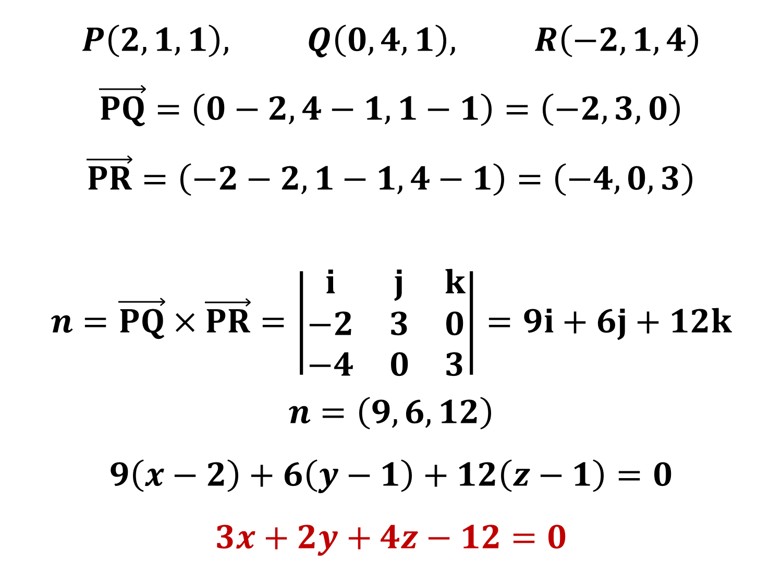
$$P\left(2,1,1\right), Q\left(0, 4, 1\right), R\left(−2,1,4\right)$$
$$\vec{PQ}=\left(0−2,4−1,1−1\right)=\left(−2,3,0\right)$$
$$\vec{PR}=\left(−2−2,1−1,4−1\right)=\left(−4,0,3\right)$$
$$n=\vec{PQ}×\vec{PR}=\left|\begin{matrix}i & j & k \\ −2 & 3 & 0 \\ −4 & 0 & 3\end{matrix}\right|=9i+6j+12k$$
$$n=\left(9,6,12\right)$$
$$9\left(x−2\right)+6\left(y−1\right)+12\left(z−1\right)=0$$
$$3x+2y+4z−12=0$$

Slide 20
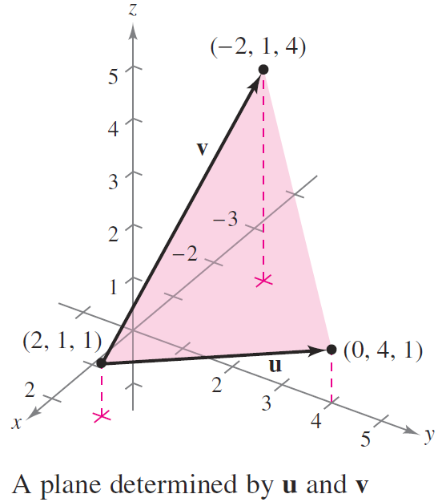
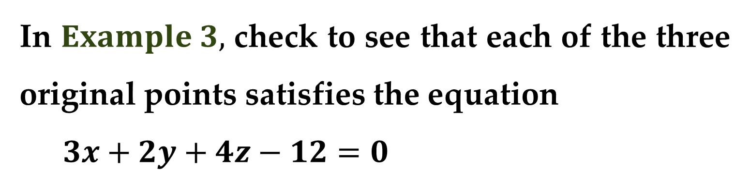
In $Example 3,$ check to see that each of the three original points satisfies the equation
$3x+2y+4z−12=0$

Slide 21
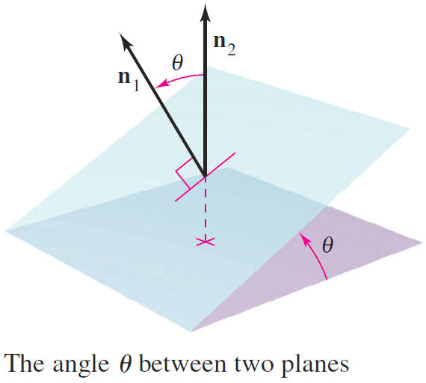
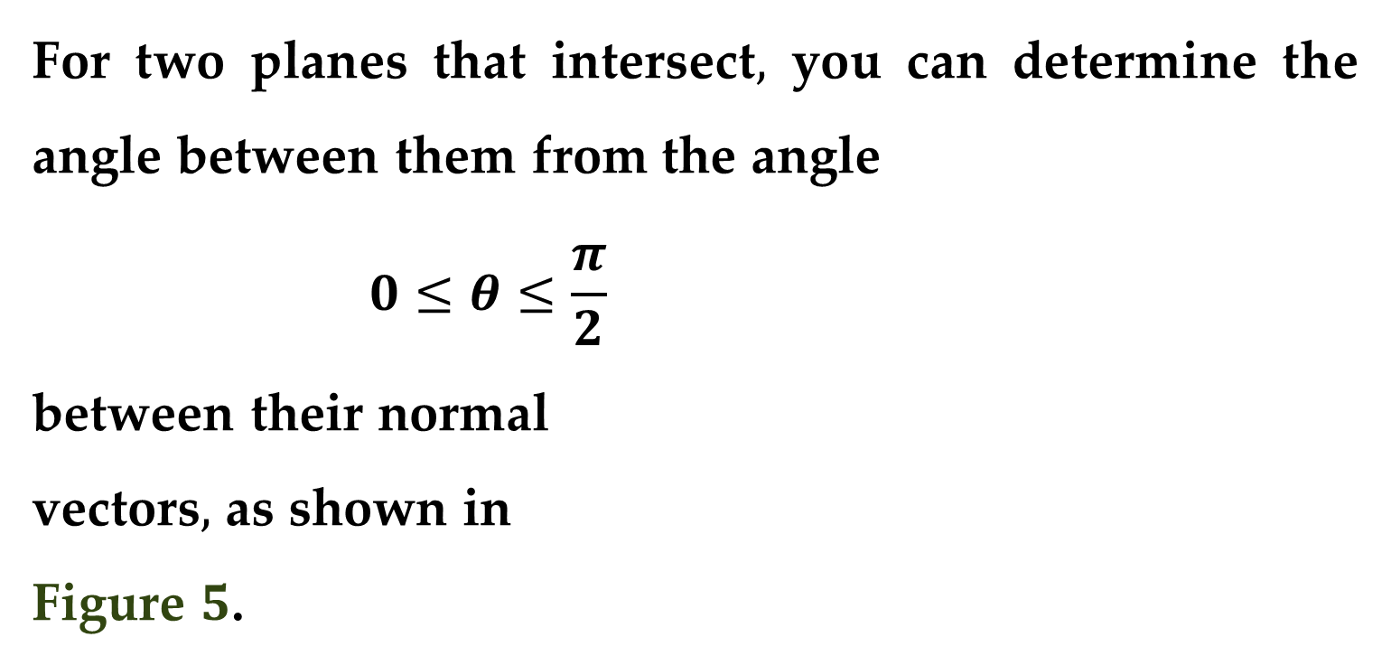
Two distinct planes in space either are parallel or intersect in a line.
For two planes that intersect$,$ you can determine the angle between them from the angle
$$0≤θ≤\frac{π}{2}$$
between their normal
vectors$,$ as shown in
Figure $5$.

Slide 22
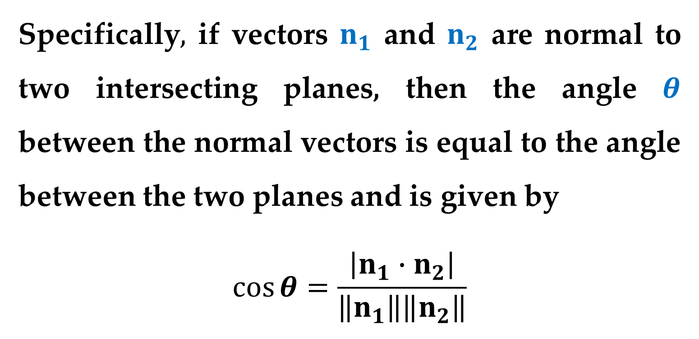
Specifically$,$ if vectors $n_{1}$ and $n_{2}$ are normal to two intersecting planes, then the angle $θ$ between the normal vectors is equal to the angle between the two planes and is given by
$$\cos{θ}=\frac{\left|n_{1}∙n_{2}\right|}{\left\|n_{1}\right\|\left\|n_{2}\right\|}$$

Slide 23
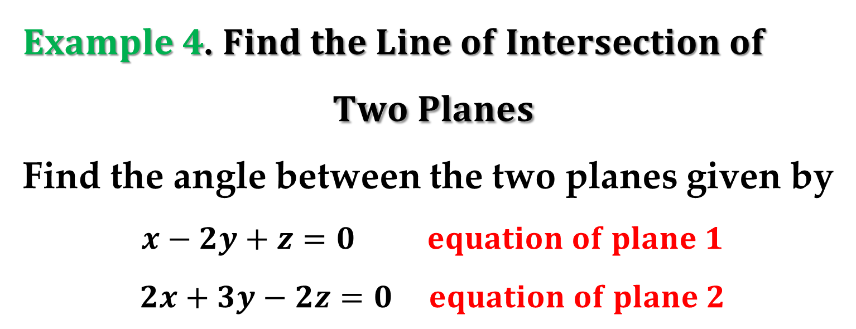
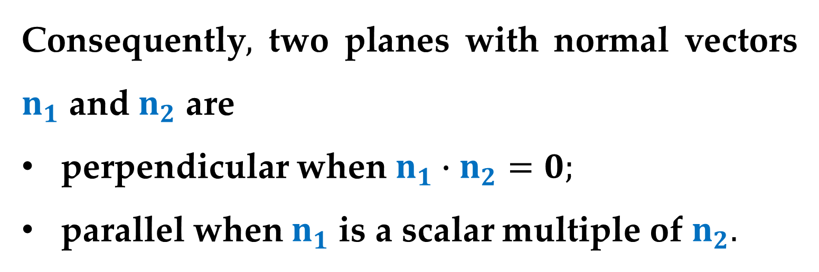
Consequently$,$ two planes with normal vectors $n_{1}$ and $n_{2}$ are
perpendicular when $n_{1}∙n_{2}=0;$
parallel when $n_{1}$ is a scalar multiple of $n_{2}.$
$Example 4$. $Find the Line of Intersection of$
$$Two Planes$$
Find the angle between the two planes given by
$$x−2y+z=0 equation of plane 1$$
$$2x+3y−2z=0 equation of plane 2$$

Slide 24
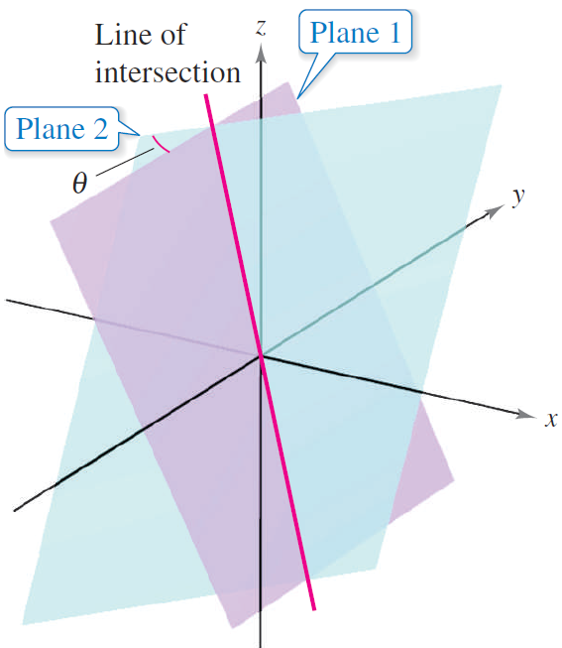
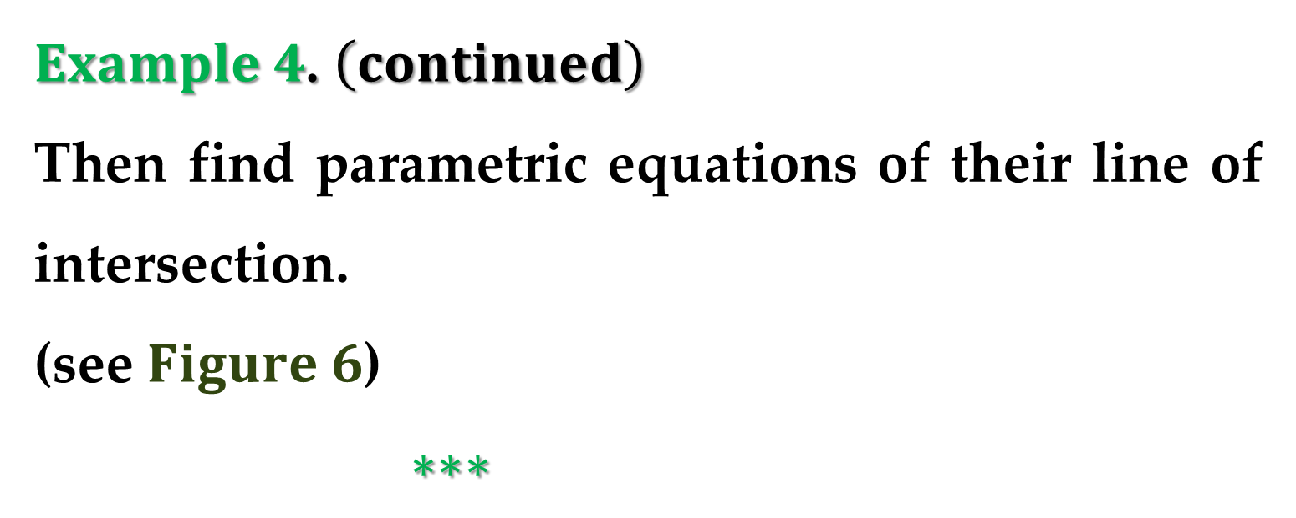
$Example 4$. $\left(continued\right)$
Then find parametric equations of their line of intersection.
(see $Figure 6$)
$∗∗∗$

Slide 25
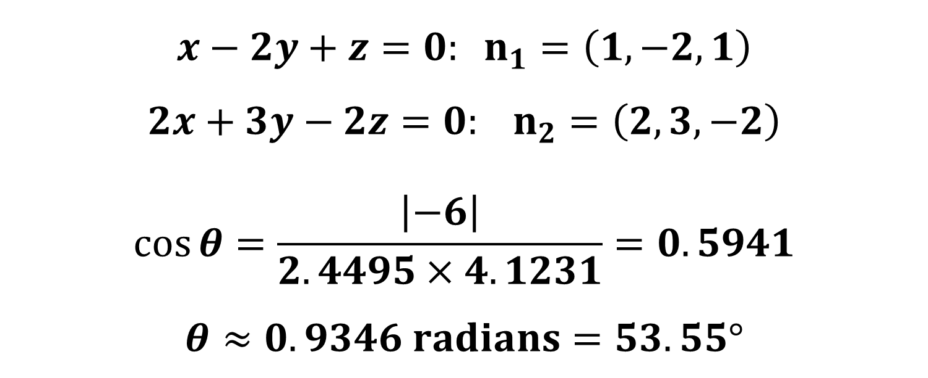
$$x−2y+z=0: n_{1}=\left(1,−2,1\right)$$
$$2x+3y−2z=0: n_{2}=\left(2,3,−2\right)$$
$$\cos{θ}=\frac{\left|−6\right|}{2.4495×4.1231}=0.5941$$
$$θ≈0.9346 radians=53.55°$$

Slide 26
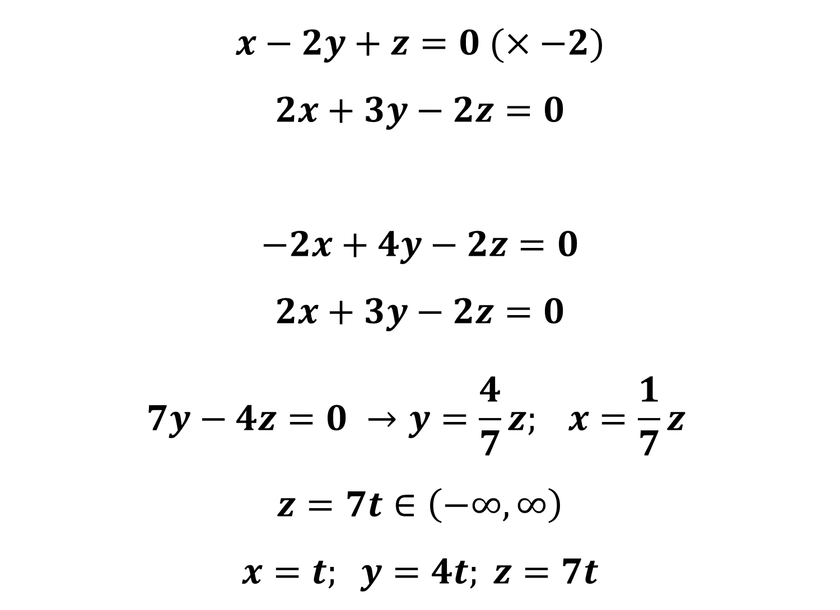
$$x−2y+z=0 (×−2)$$
$$2x+3y−2z=0$$
$$−2x+4y−2z=0$$
$$2x+3y−2z=0$$
$$7y−4z=0 →y=\frac{4}{7}z; x=\frac{1}{7}z$$
$$z=7t∈\left(−∞,∞\right)$$
$$x=t; y=4t; z=7t$$

Slide 27
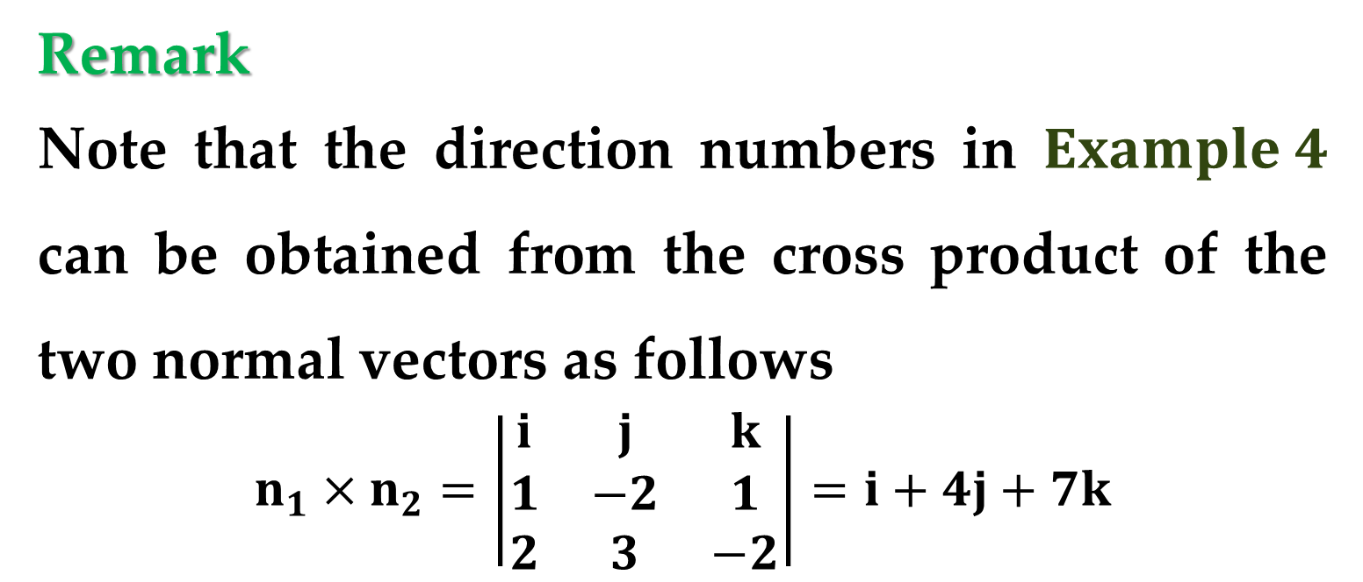
Remark
Note that the direction numbers in $Example 4$ can be obtained from the cross product of the two normal vectors as follows
$$n_{1}×n_{2}=\left|\begin{matrix}i & j & k \\ 1 & −2 & 1 \\ 2 & 3 & −2\end{matrix}\right|=i+4j+7k$$
This means that the line of intersection of the two planes is parallel to the cross product of their normal vectors.

Slide 28
Sketching Planes in Space

Slide 29
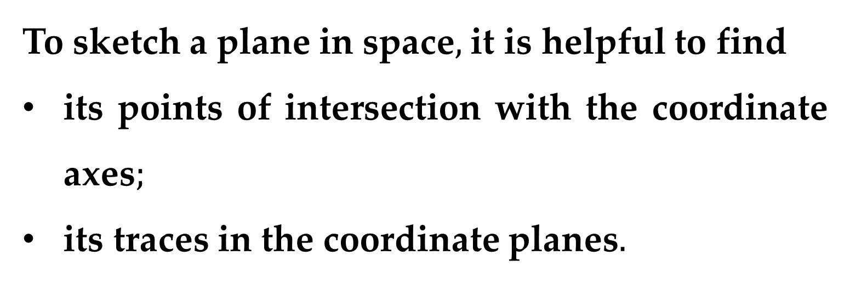
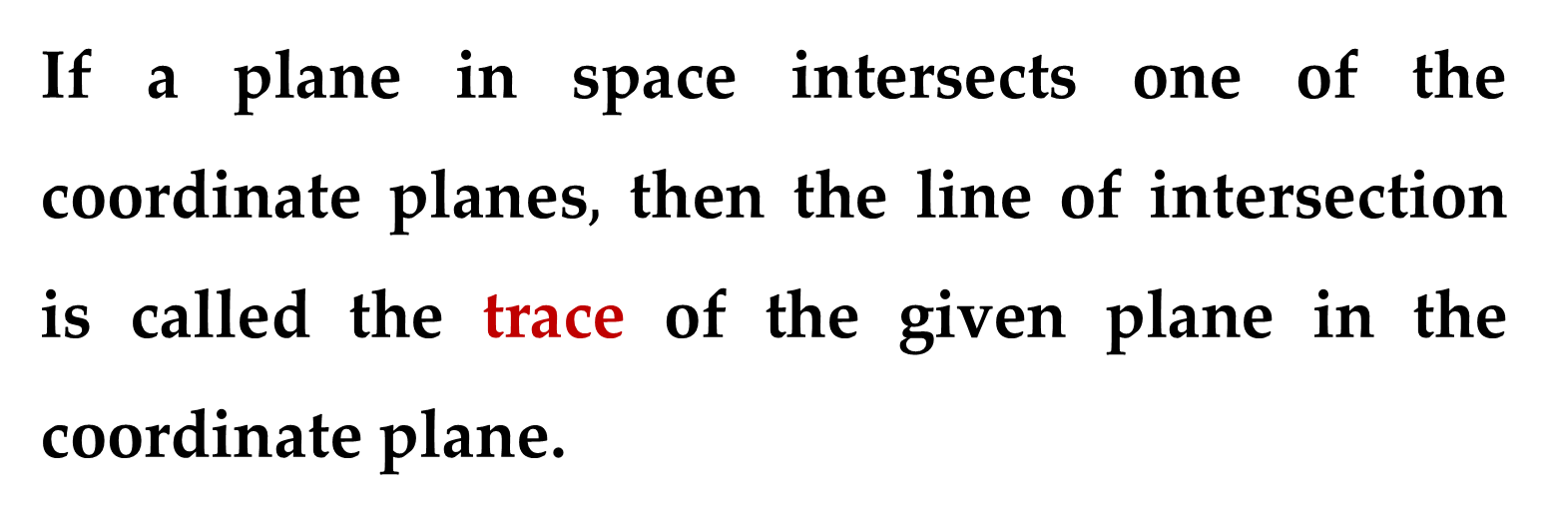
If a plane in space intersects one of the coordinate planes$,$ then the line of intersection is called the trace of the given plane in the coordinate plane.
To sketch a plane in space$,$ it is helpful to find
its points of intersection with the coordinate axes$;$
its traces in the coordinate planes$.$

Slide 30
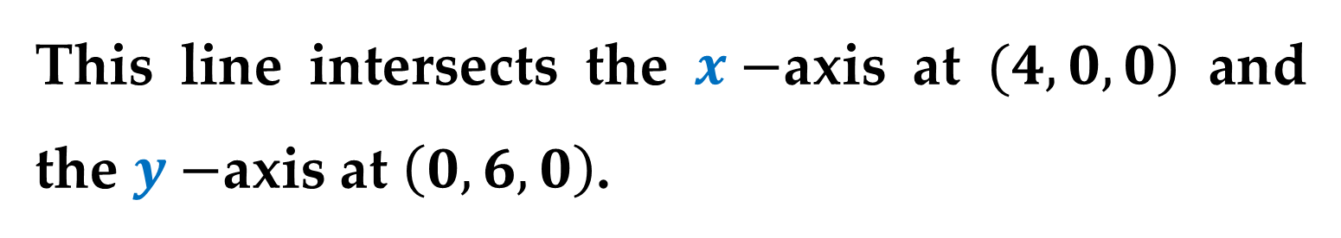
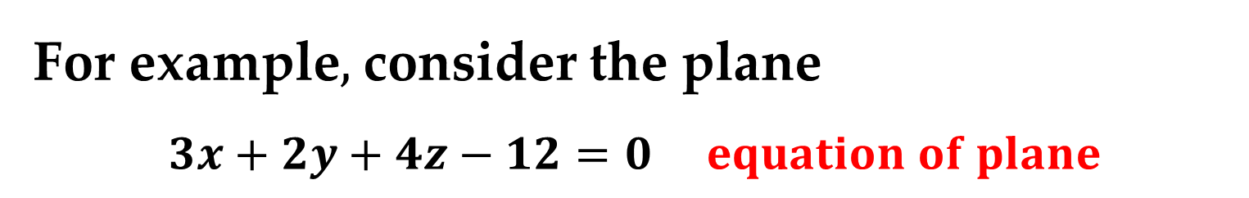
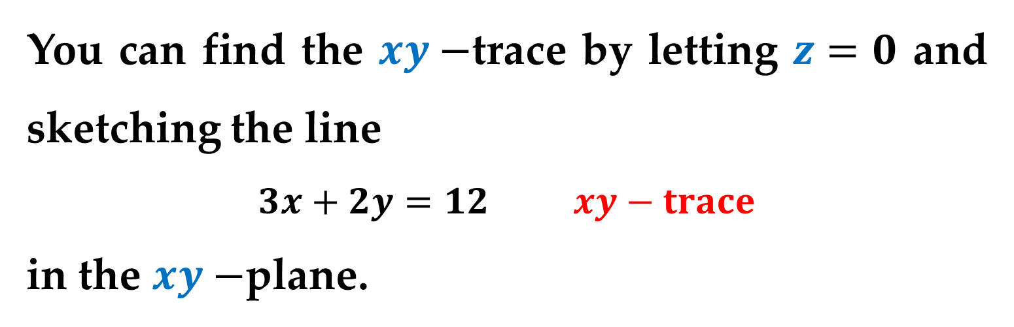
For example$,$ consider the plane
$$3x+2y+4z−12=0 equation of plane$$
You can find the $xy−$trace by letting $z=0$ and sketching the line
$$3x+2y=12 xy−trace$$
in the $xy−$plane.
This line intersects the $x−$axis at $(4,0,0)$ and the $y−$axis at $\left(0,6,0\right)$.

Slide 31
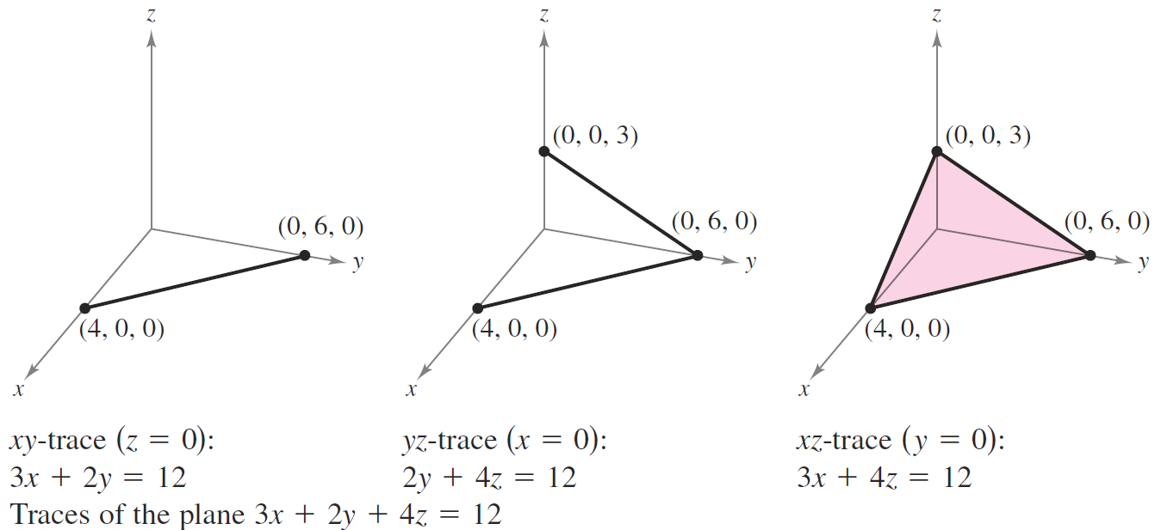
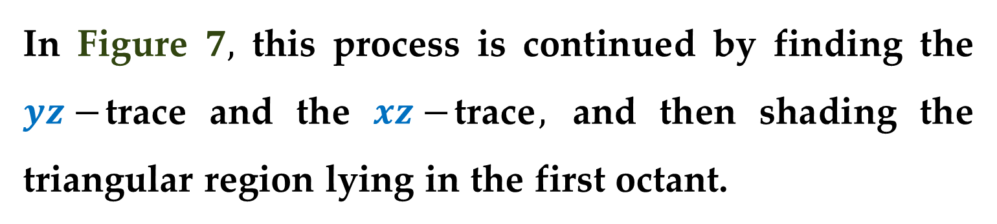
In Figure $7,$ this process is continued by finding the $yz−$trace and the $xz−$trace$,$ and then shading the triangular region lying in the first octant.

Slide 32
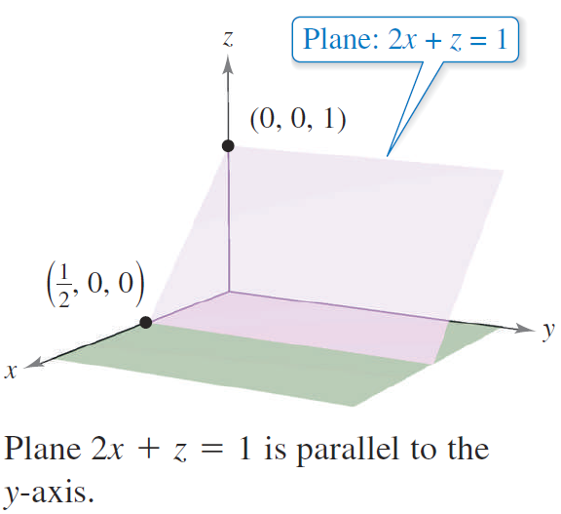
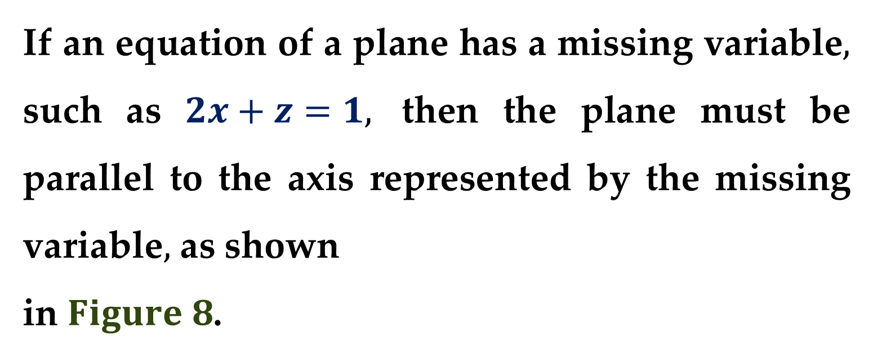
If an equation of a plane has a missing variable$,$ such as $2x+z=1,$ then the plane must be parallel to the axis represented by the missing variable$,$ as shown
in $Figure 8$.

Slide 33
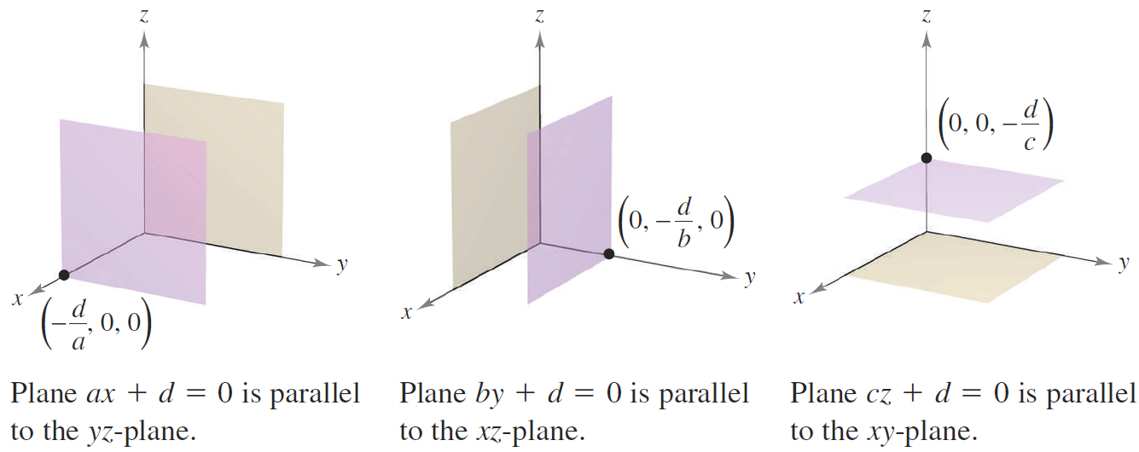

If two variables are missing from an equation of a plane$,$ such as $ax+d=0,$ then it is parallel to the coordinate plane represented by the missing variables$,$ as shown in $Figure 9$.

Slide 34
Distances in Space

Slide 35

Consider two types of problems involving distances in space:
finding the distance between a point and a plane$;$
finding the distance between a point and a line$.$

Slide 36

The solutions of these problems illustrate the versatility and usefulness of vectors in coordinate geometry:
the first problem uses the dot product of two vectors$;$
the second problem uses the cross product of two vectors$.$

Slide 37


$Distance Between a Point and a Plane$
The distance $D$ between a point $Q$ and a plane is the length of the shortest line segment connecting $Q$ to the plane$,$
as shown in $Figure 10$.

Slide 38

For any point $P$ in the plane$,$ you can find this distance by projecting the vector $\vec{PQ}$ onto the normal vector $n$.
The length of this projection is the desired distance.

Slide 39

$Theorem 3$. $Distance Between a Point$
$$and a Plane$$
The distance between a plane and a point $Q$ (not in the plane) is
$$D=\left\|proj_{n} \vec{PQ}\right\|=\frac{\left|\vec{PQ}∙n\right|}{\left\|n\right\|}$$
where $P$ is a point in the plane and $n$ is normal to the plane.

Slide 40


To find a point in the plane given by
$$ax+by+cz+d=0 (a≠0)$$
let $y=0$ and $z=0$.
Then$,$ from the equation you can conclude that the point $\left(−\frac{d}{a}, 0, 0\right)$ lies in the plane.

Slide 41

$Example 5$. $Find the Distance Between a Point$
$$and a Plane$$
Find the distance between the point $Q\left(1, 5, −4\right)$ and the plane given by
$$3x−y+2z=6$$
$$∗∗∗$$

Slide 42

Find the distance between the point $Q\left(1, 5, −4\right)$ and the plane given by
$$3x−y+2z=6$$
$$D=\left\|proj_{n} \vec{PQ}\right\|=\frac{\left|\vec{PQ}∙n\right|}{\left\|n\right\|}=\frac{16}{3.7417}≈4.2762$$
$$n=\left(3,−1,2\right)$$
$$P_{1}\left(2,0,0\right); P_{2}\left(0,0,3\right)$$
$$\vec{P_{1}Q}=\left(1−2,5−0,−4−0\right)=\left(−1,5,−4\right)$$

Slide 43


Remark
In the solution to Example $5,$ note that the choice of the point $P$ is arbitrary.
Try choosing a different point in the plane to verify that you obtain the same distance.
$$∗∗∗$$

Slide 44

From $Theorem 3,$ you can determine that the distance between the point $Q\left(x_{0},y_{0},z_{0}\right)$ and the plane given by
$$ax+by+cz+d=0$$
is
$$D=\frac{\left|a{(x}_{0}−x_{1})+b(y_{0}−y_{1})+c(z_{0}−z_{1})\right|}{\sqrt{a^{2}+b^{2}+c^{2}}}$$
or
$$D=\frac{\left|ax_{0}+by_{0}+cz_{0}+d\right|}{\sqrt{a^{2}+b^{2}+c^{2}}}$$
where $P\left(x_{1},y_{1},z_{1}\right)$ is a point in the plane and
$$d=−\left(ax_{1}+by_{1}+cz_{1}\right)$$

Slide 45


$Example 6$. $Find the Distance Between Two$
$$Parallel Planes$$
Find the distance between the two parallel planes given by
$3x−y+2z=6$
and
$6x−2y+4z=−4$
as shown in $Figure 11$.
$∗∗∗$

Slide 46

$3x−y+2z=6$:
$$Q\left(2,0,0\right)$$
$6x−2y+4z=−4$ :
$$P\left(0,0,−1\right)$$
$$n=\left(6,−2,4\right)$$
$$\vec{PQ}=\left(2−0,0−0,0−\left(−1\right)\right)=\left(2,0,1\right)$$
$$D=\left\|proj_{n} \vec{PQ}\right\|=\frac{\left|\vec{PQ}∙n\right|}{\left\|n\right\|}≈2.1381$$

Slide 47

$Distance Between a Point and a Line$
The formula for the distance between a point and a line in space resembles that for the distance between a point and a plane — except that you replace the dot product with the length of the cross product and the normal vector with a direction vector for the line.

Slide 48

$Theorem 4$. $Distance Between a Point and$
$$a Line in Space$$
The distance between a point $Q$ and a line in space is
$$D=\frac{\left\|\vec{PQ}×u\right\|}{\left\|u\right\|}$$
where $u$ is a direction vector for the line and $P$ is a point on the line.

Slide 49



$Proof$
In $Figure 12,$ let $D$ be the distance between the point $Q$ and the given line.
Then $D=\left\|\vec{PQ}\right\|\sin{θ}$ where $θ$ is the angle between $u$ and $\vec{PQ}$.

Slide 50


$Proof \left(continued\right)$
Recalling that
$$\left\|u×v\right\|=\left\|u\right\|\left\|v\right\|\sin{θ}$$
you have
$$\left\|u\right\|\left\|\vec{PQ}\right\|\sin{θ}=\left\|u×\vec{PQ}\right\|=\left\|\vec{PQ}×u\right\|$$
Consequently
$$D=\left\|\vec{PQ}\right\|\sin{θ}=\frac{\left\|\vec{PQ}×u\right\|}{\left\|u\right\|}$$

Slide 51


$Example 7$. $Finding the Distance Between$
$$a Point and a Line$$
Find the distance between the point $Q\left(3,−1,4\right)$ and the line given by
$x=−2+3t,$
$y=−2t,$
$z=1+4t$
$∗∗∗$

Slide 52
Thank you for attention

